Slide 1
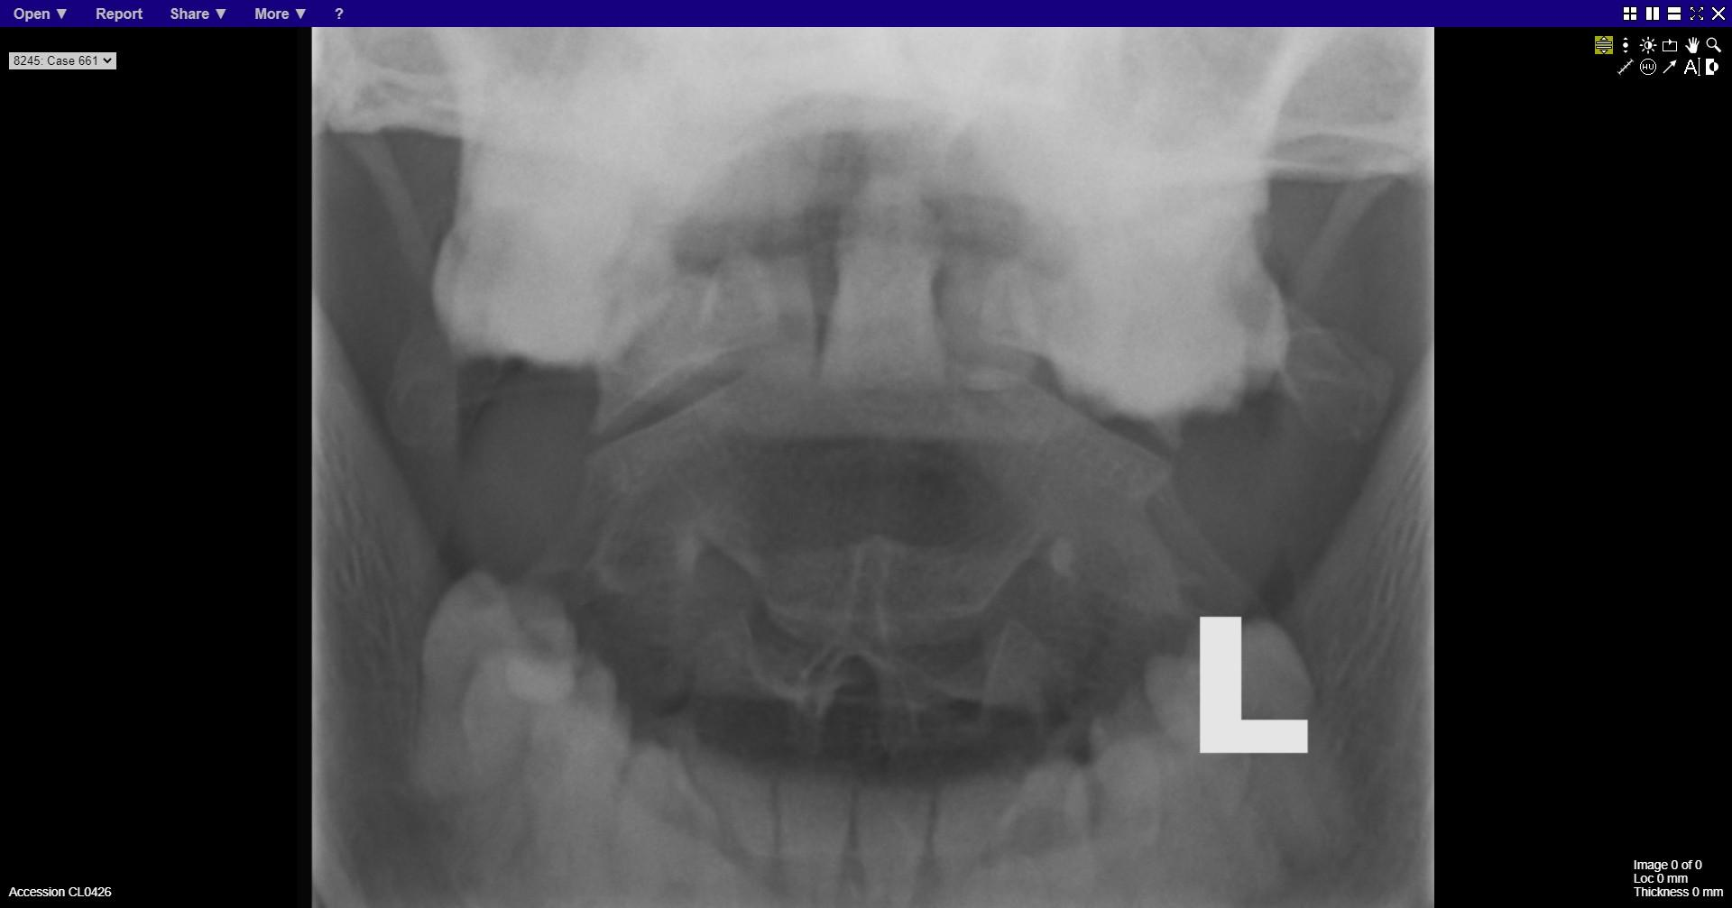
Notes:
normal

Slide 2
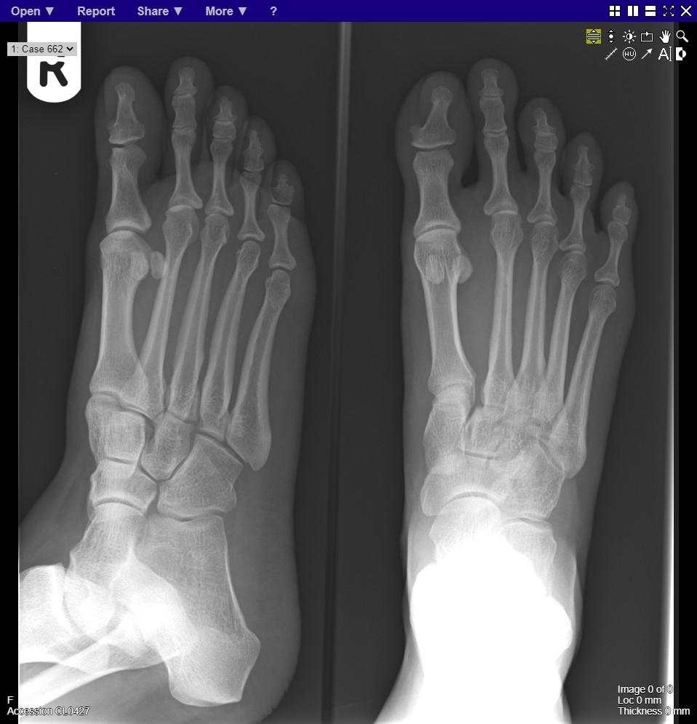
Notes:
Lisfranc injury

Slide 3
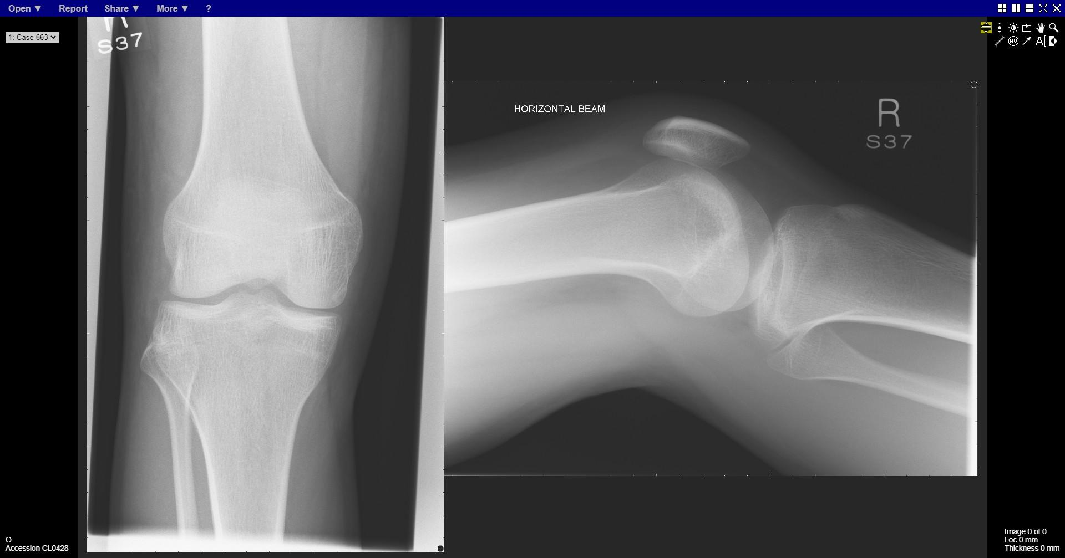
Notes:
normal

Slide 4
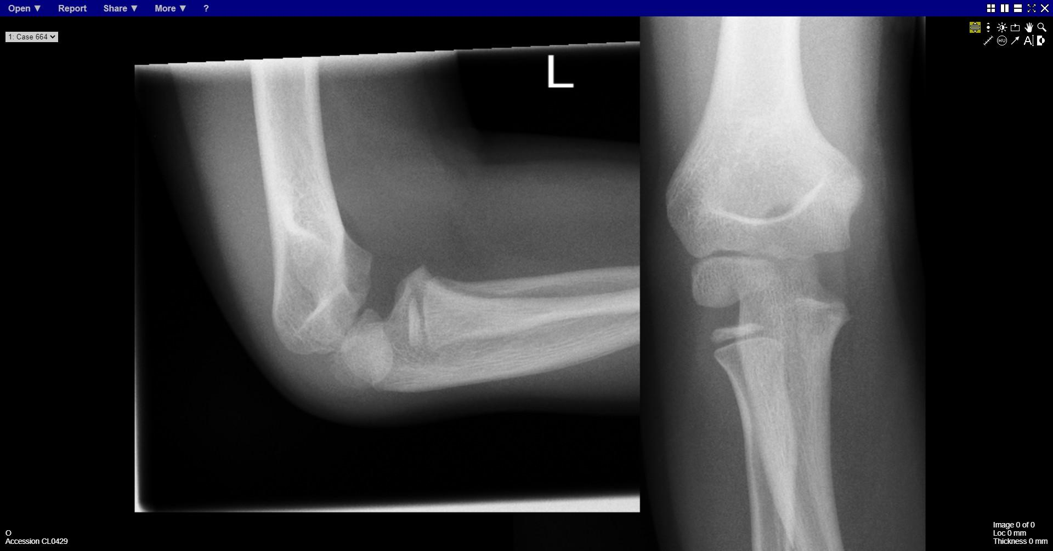
Notes:
Radiocapitellar dissociation
aka radial head dislocation

Slide 5
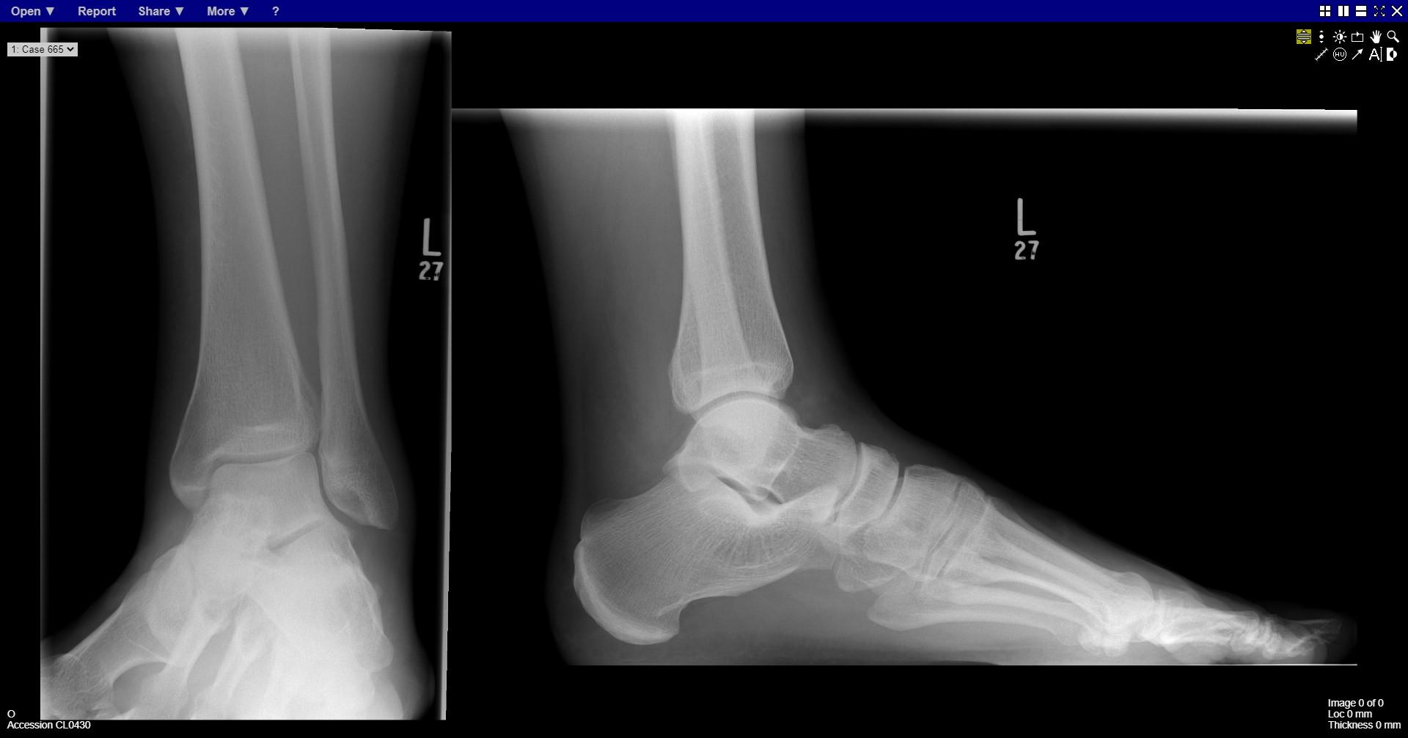
Notes:
normal

Slide 6
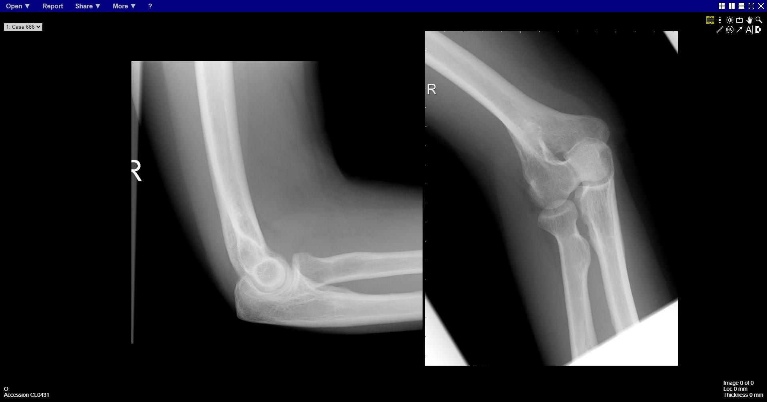
Notes:
Radial head fracture

Slide 7
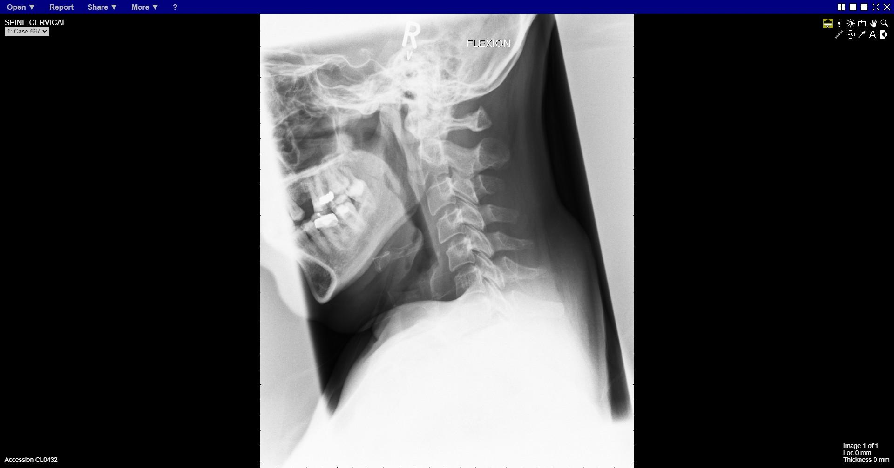
Notes:
C2 body fracture

Slide 8
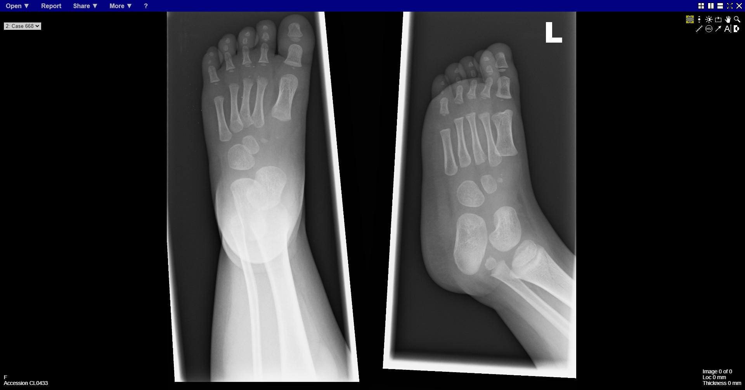
Notes:
Fracture distal tibial
Toddlers fracture

Slide 9
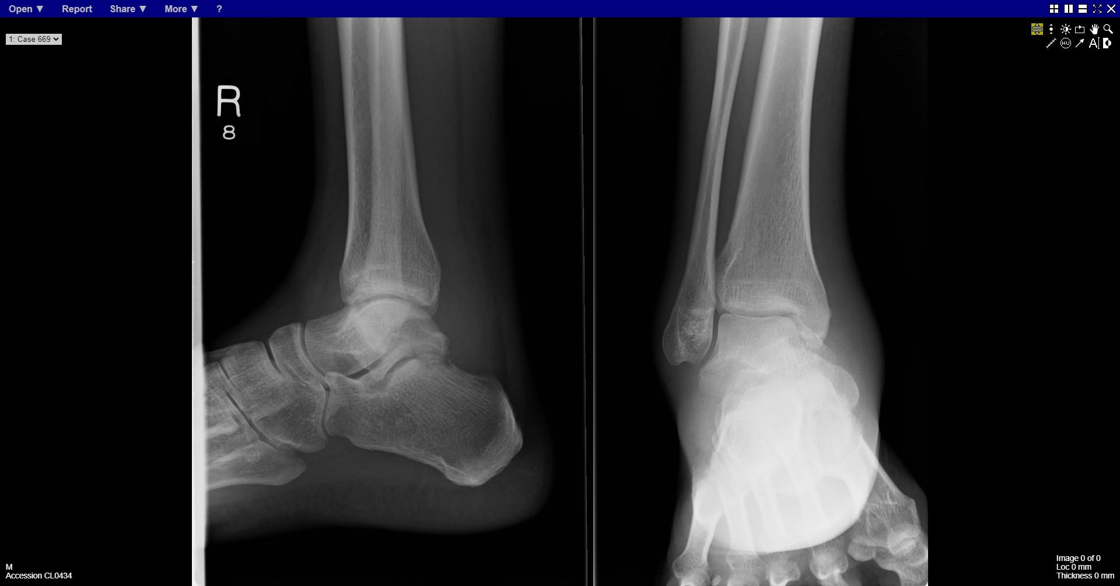
Notes:
Talar fracture

Slide 10
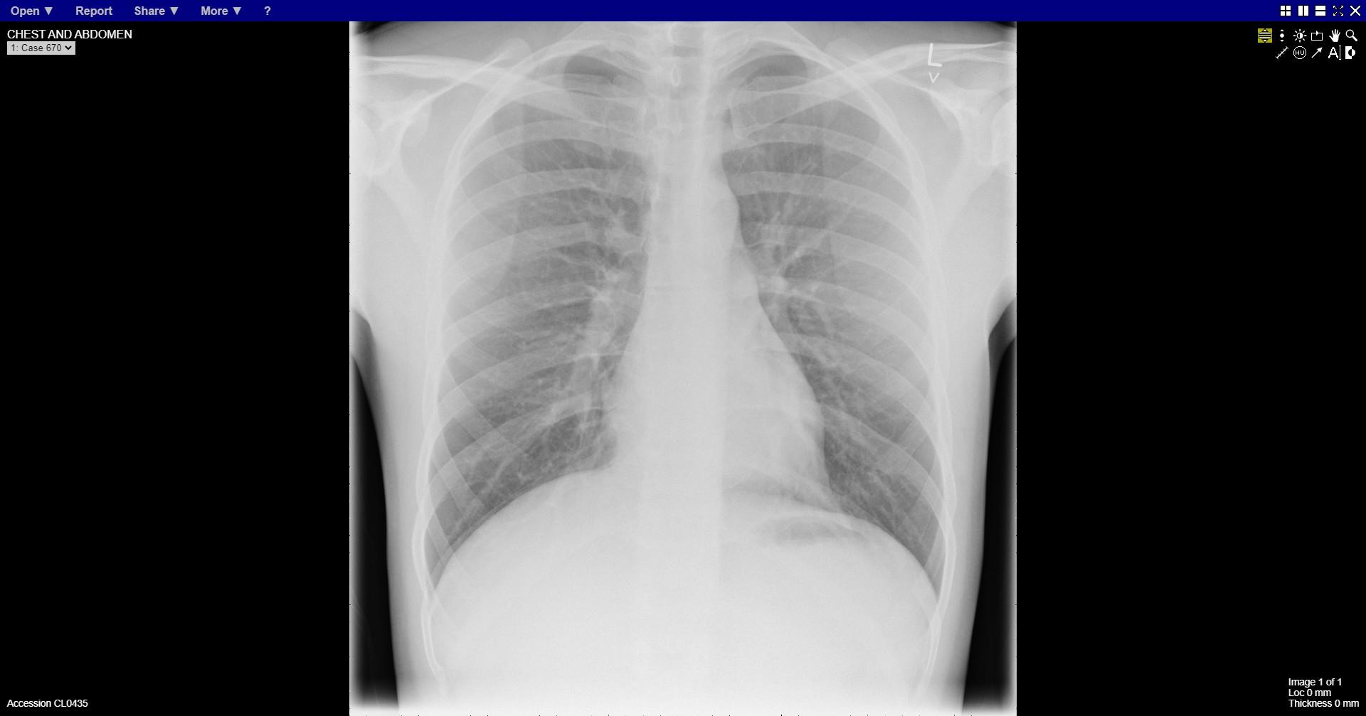
Notes:
normal

Slide 11
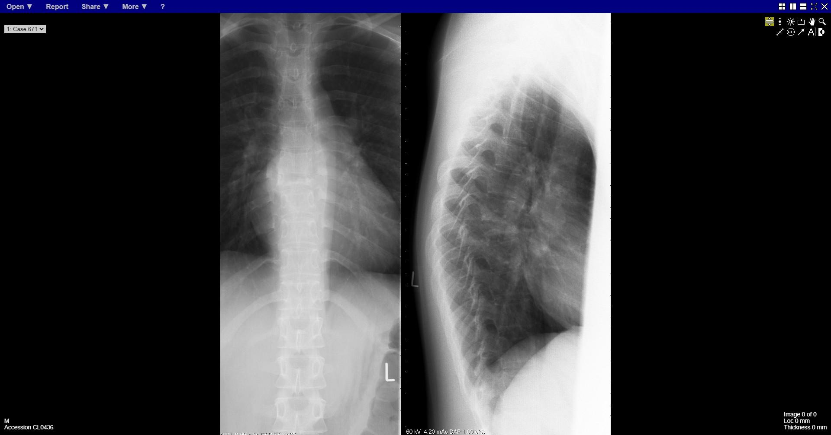
Notes:
Vertebral compression mid-thoracic

Slide 12
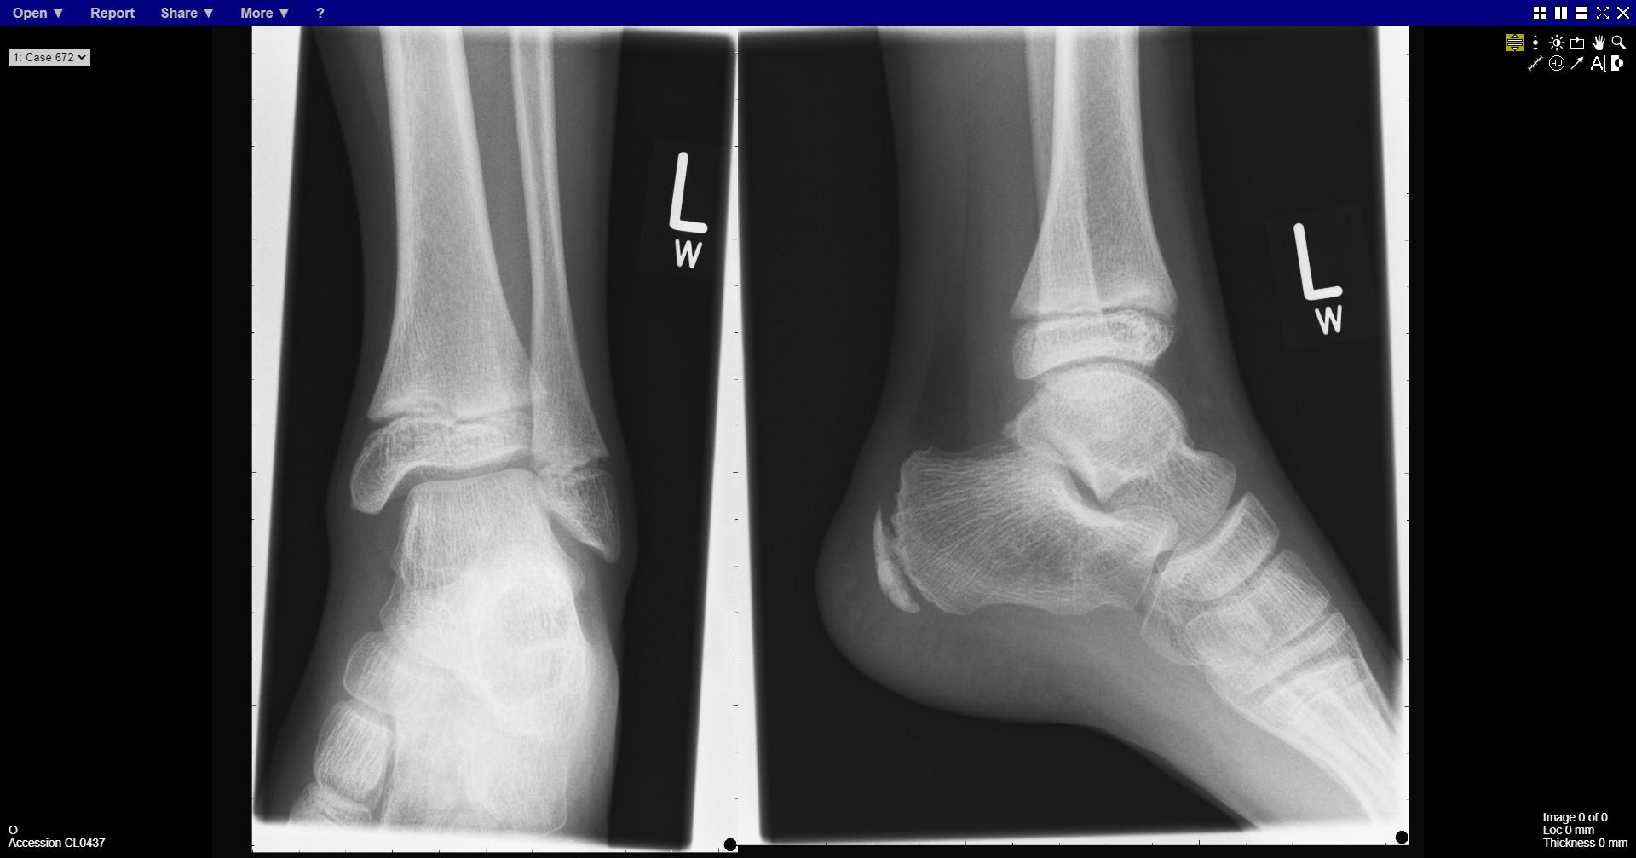
Notes:
normal

Slide 13
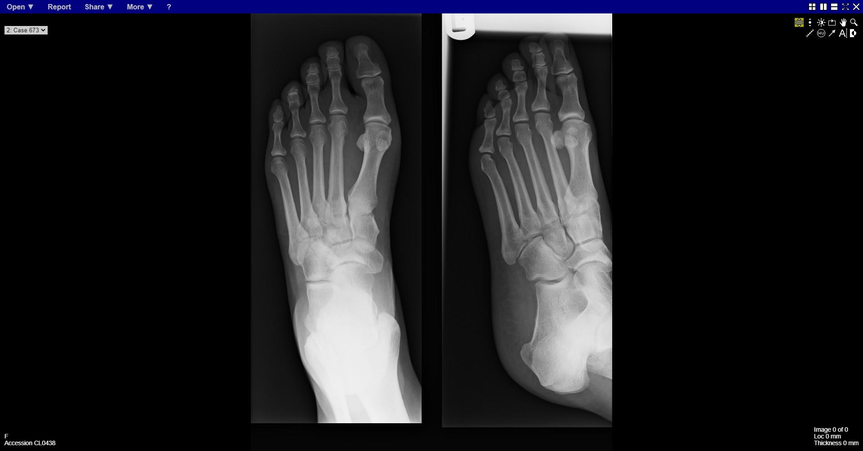
Notes:
Stress fracture – medial cortex 2nd metatarsal

Slide 14
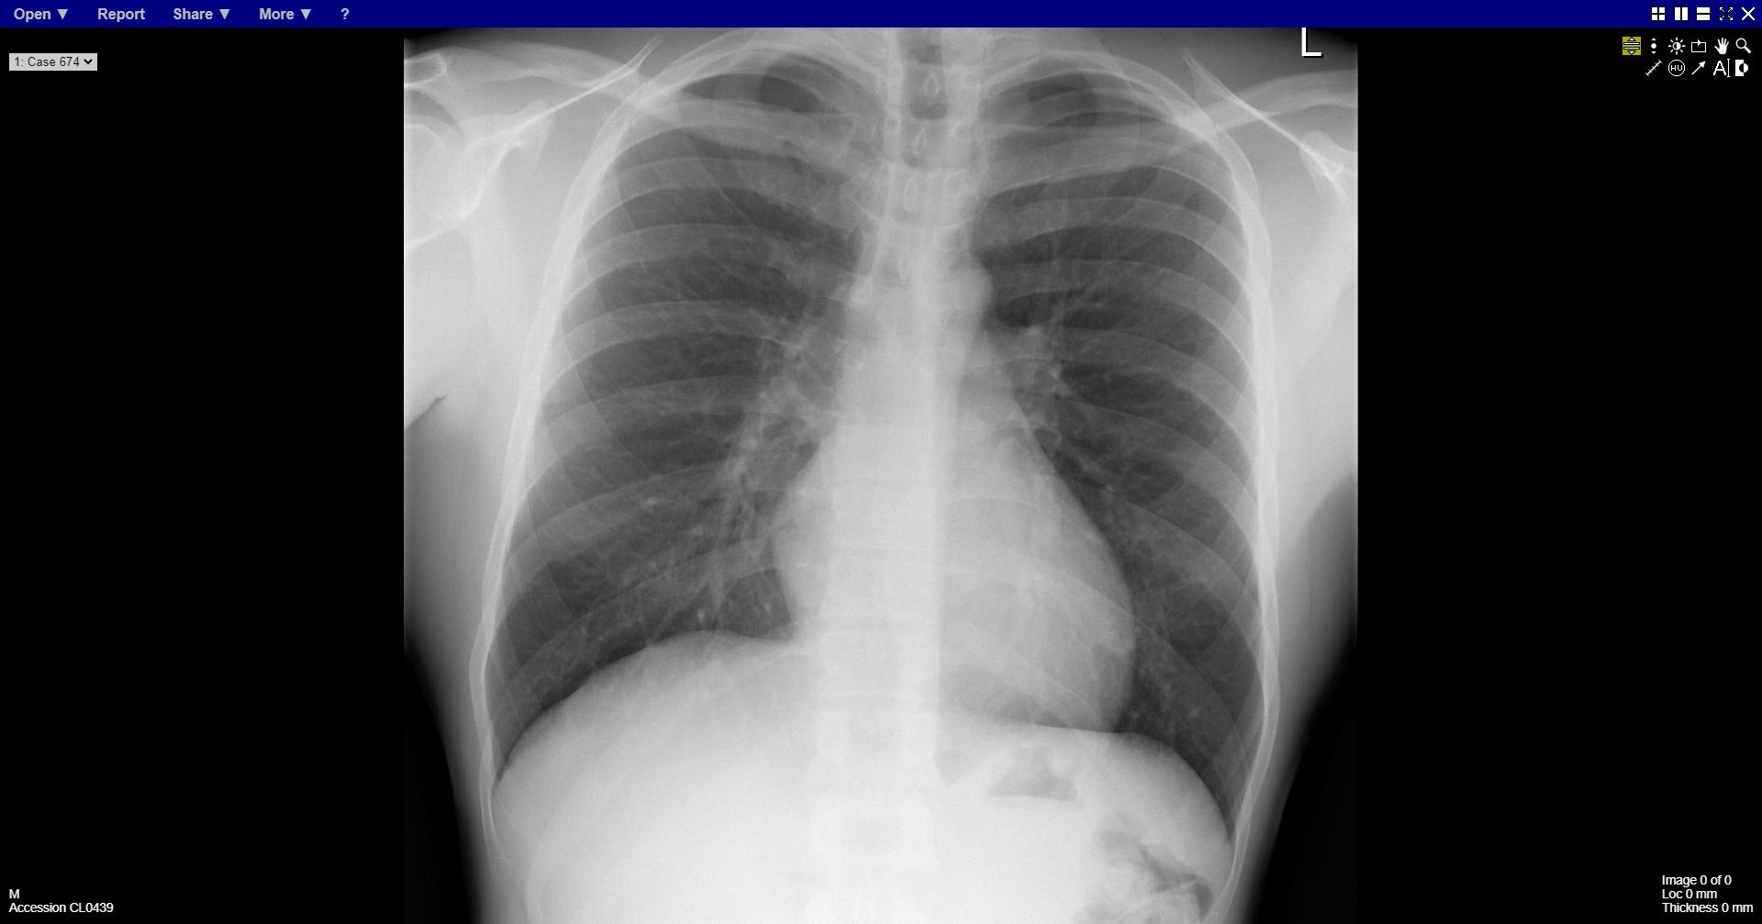
Notes:
normal

Slide 15
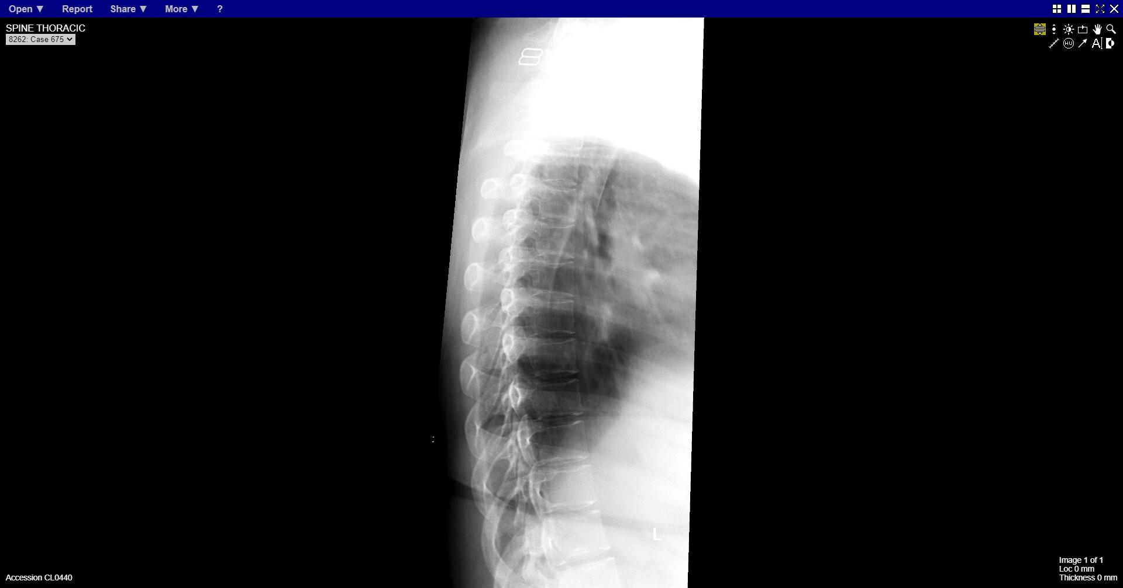
Notes:
normal

Slide 16
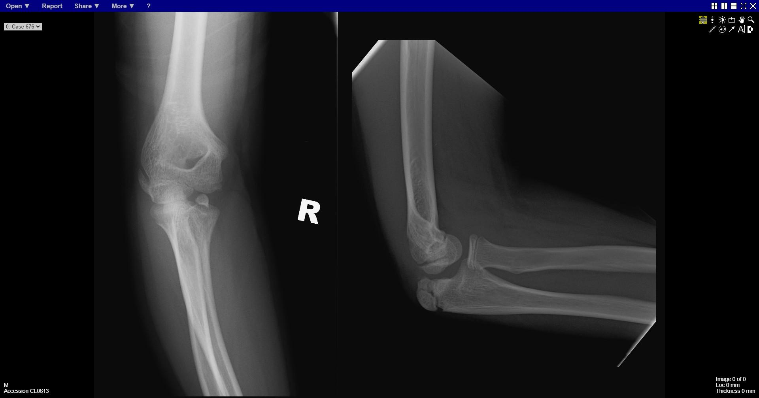
Notes:
Avulsed medial epicondyle

Slide 17
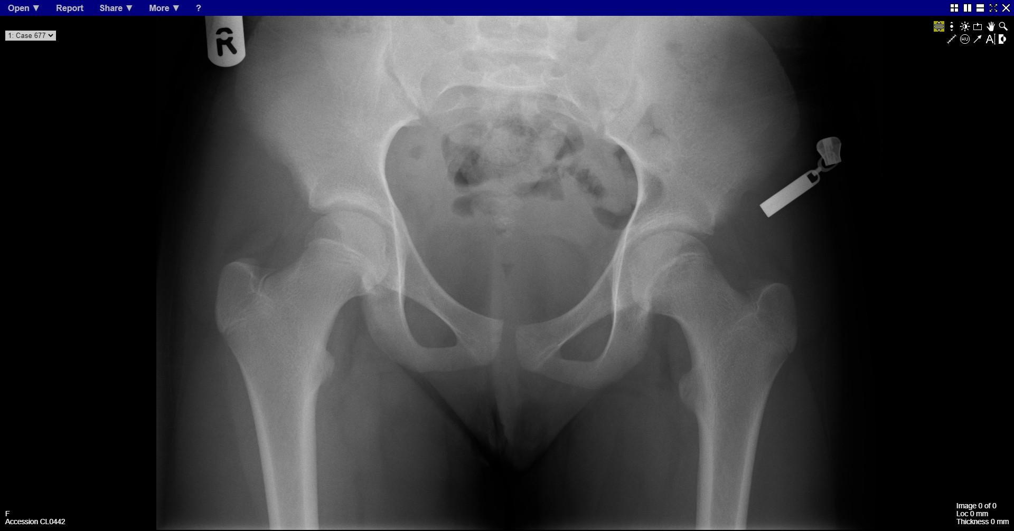
Notes:
left sufe

Slide 18
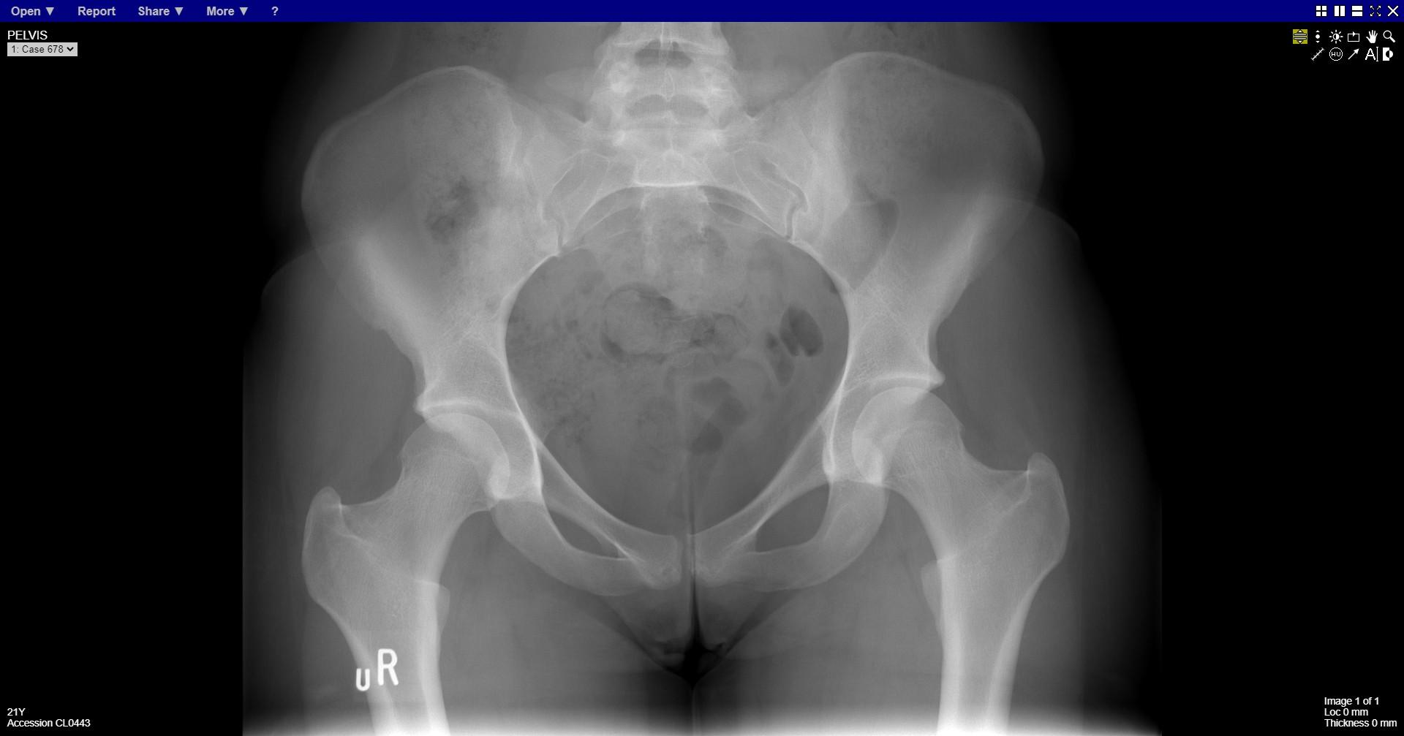
Notes:
normal

Slide 19
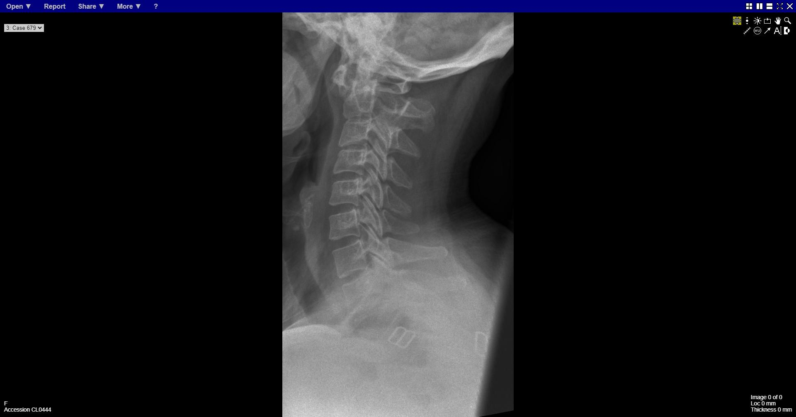
Notes:
C1/C2 subluxation

Slide 20
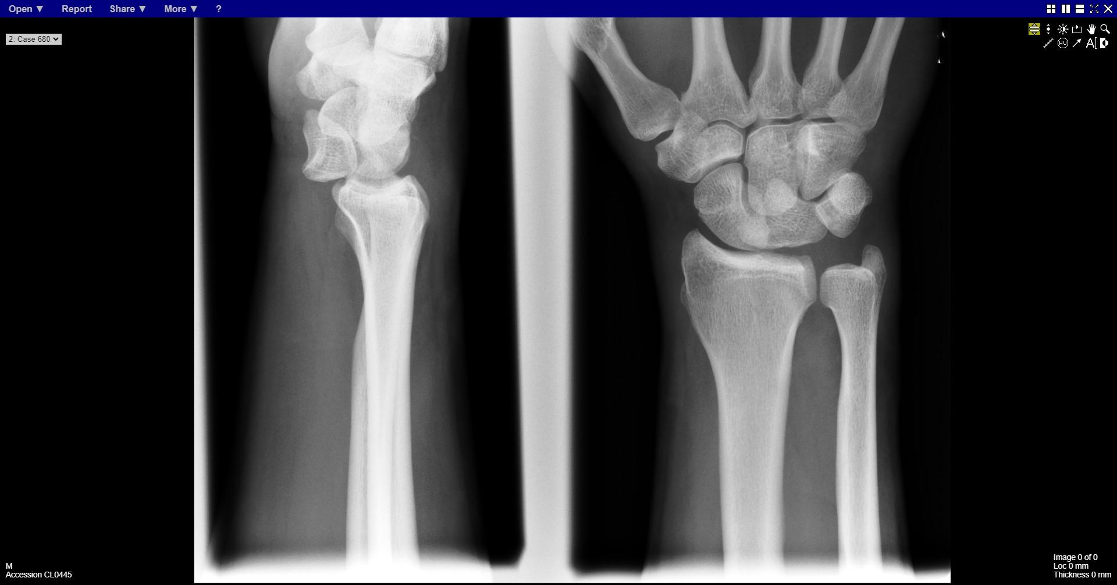
Notes:
Lunate dislocation

Slide 21
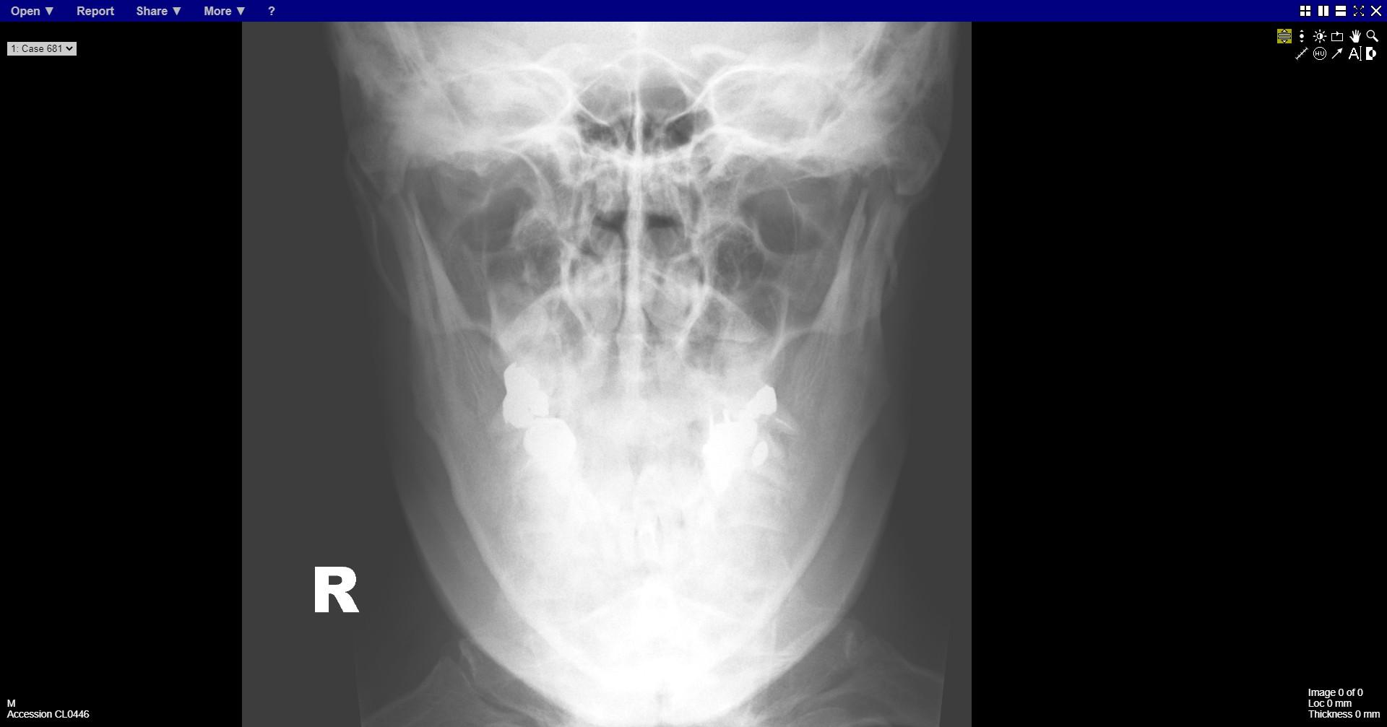
Notes:
Bilateral condylar fractures

Slide 22
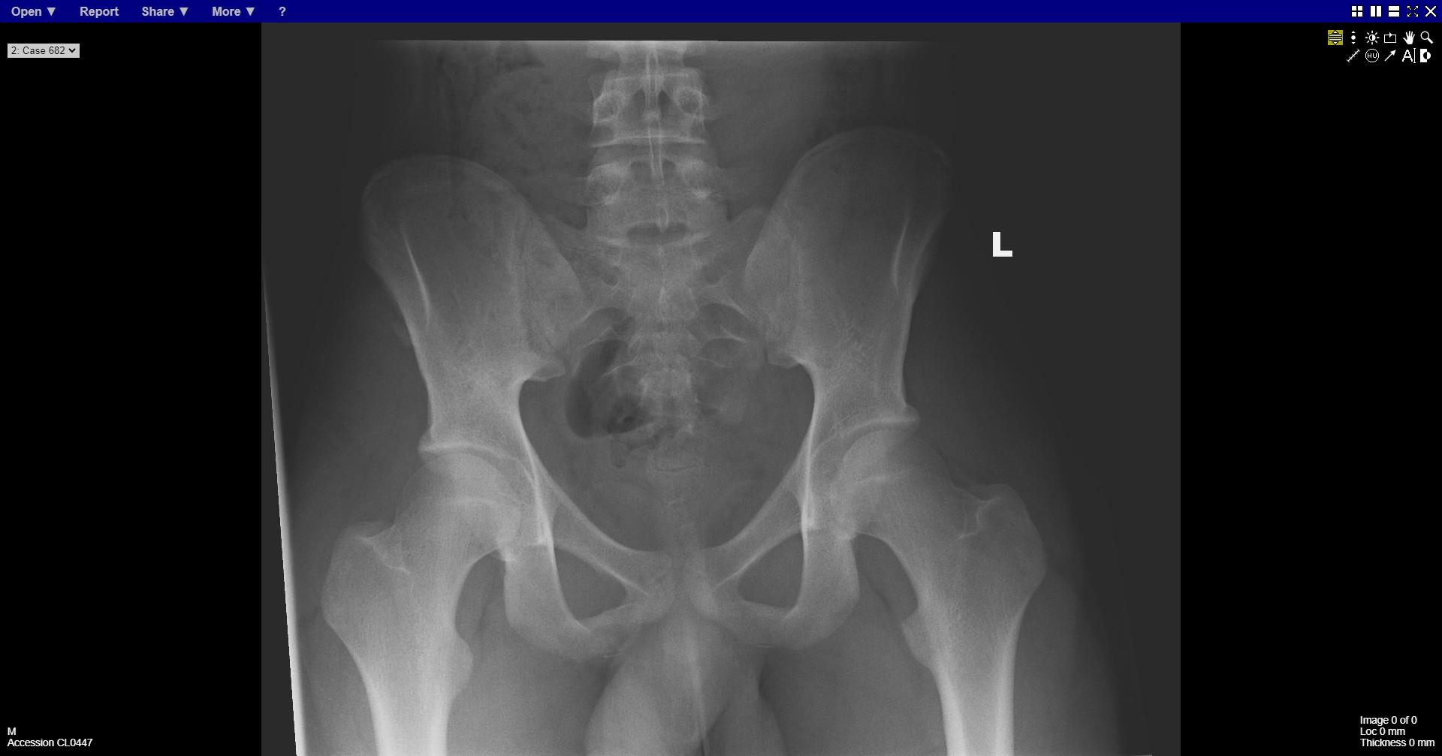
Notes:
ASIS avulsion

Slide 23
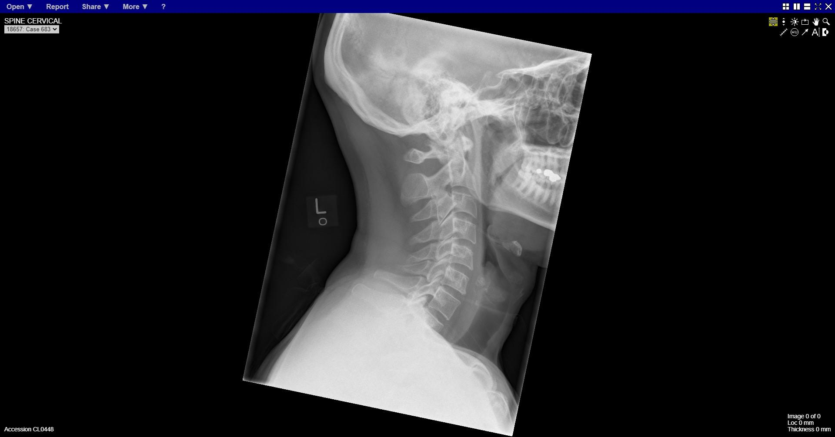
Notes:
normal

Slide 24
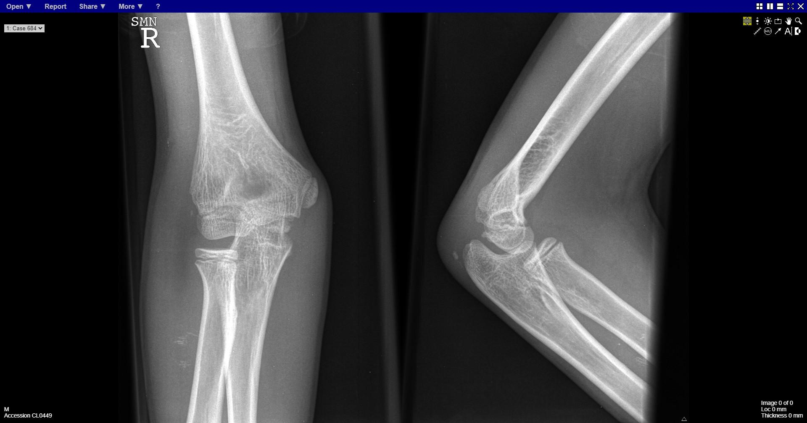
Notes:
normal

Slide 25
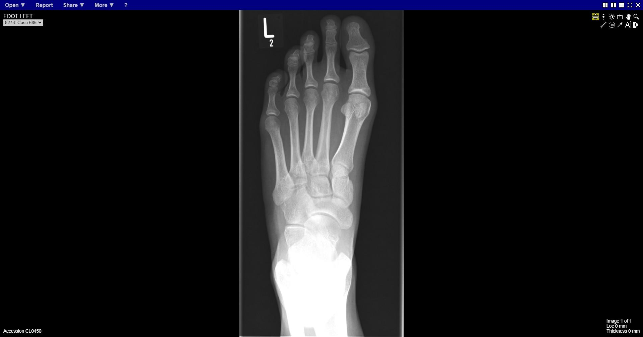
Notes:
normal

Slide 26
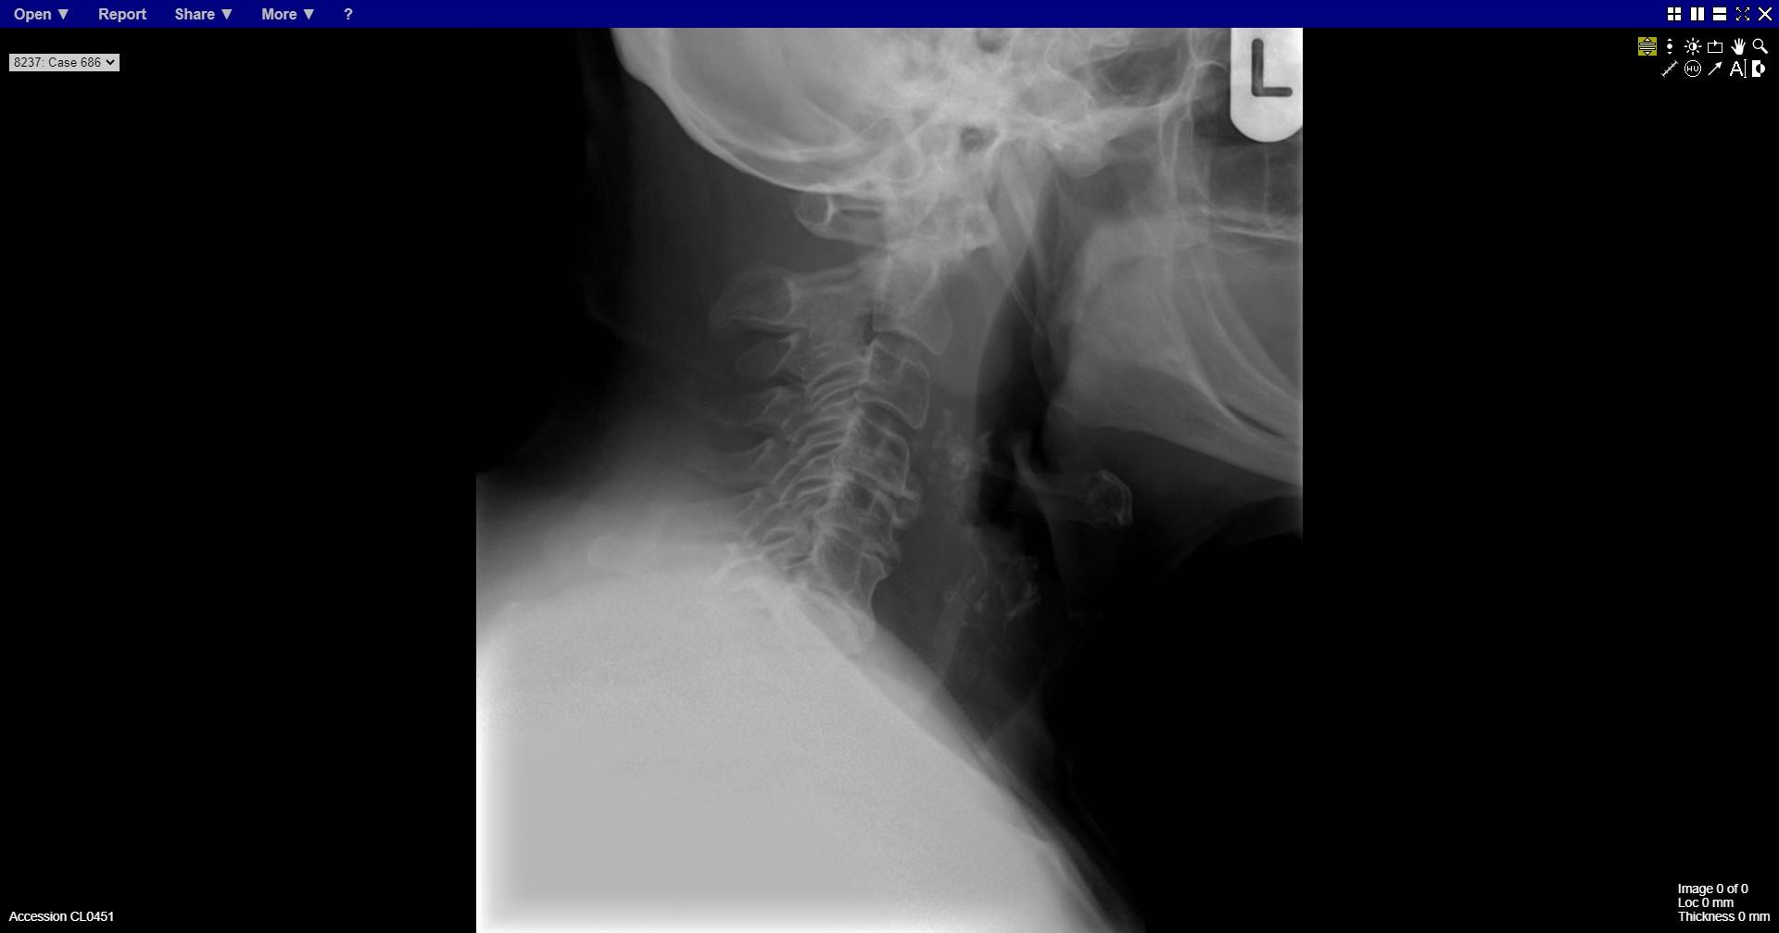
Notes:
Odontoid peg fracture

Slide 27
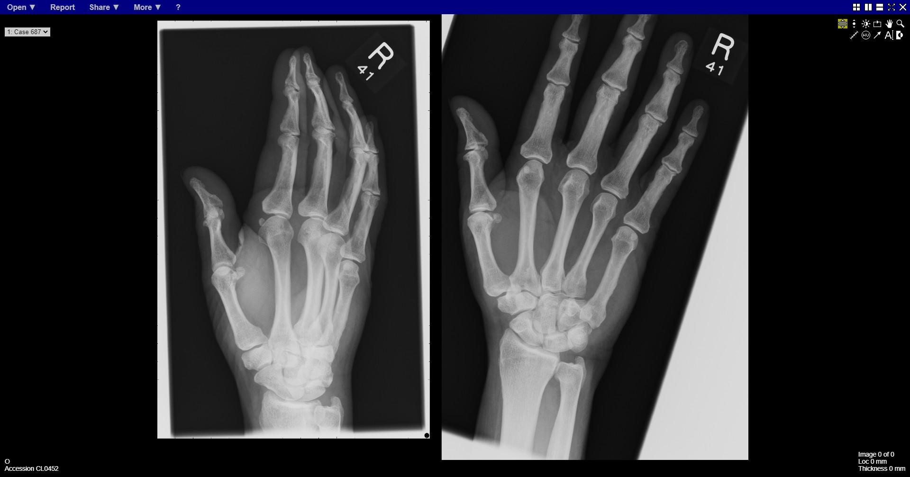
Notes:
Dislocated base of 5th metacarpal

Slide 28
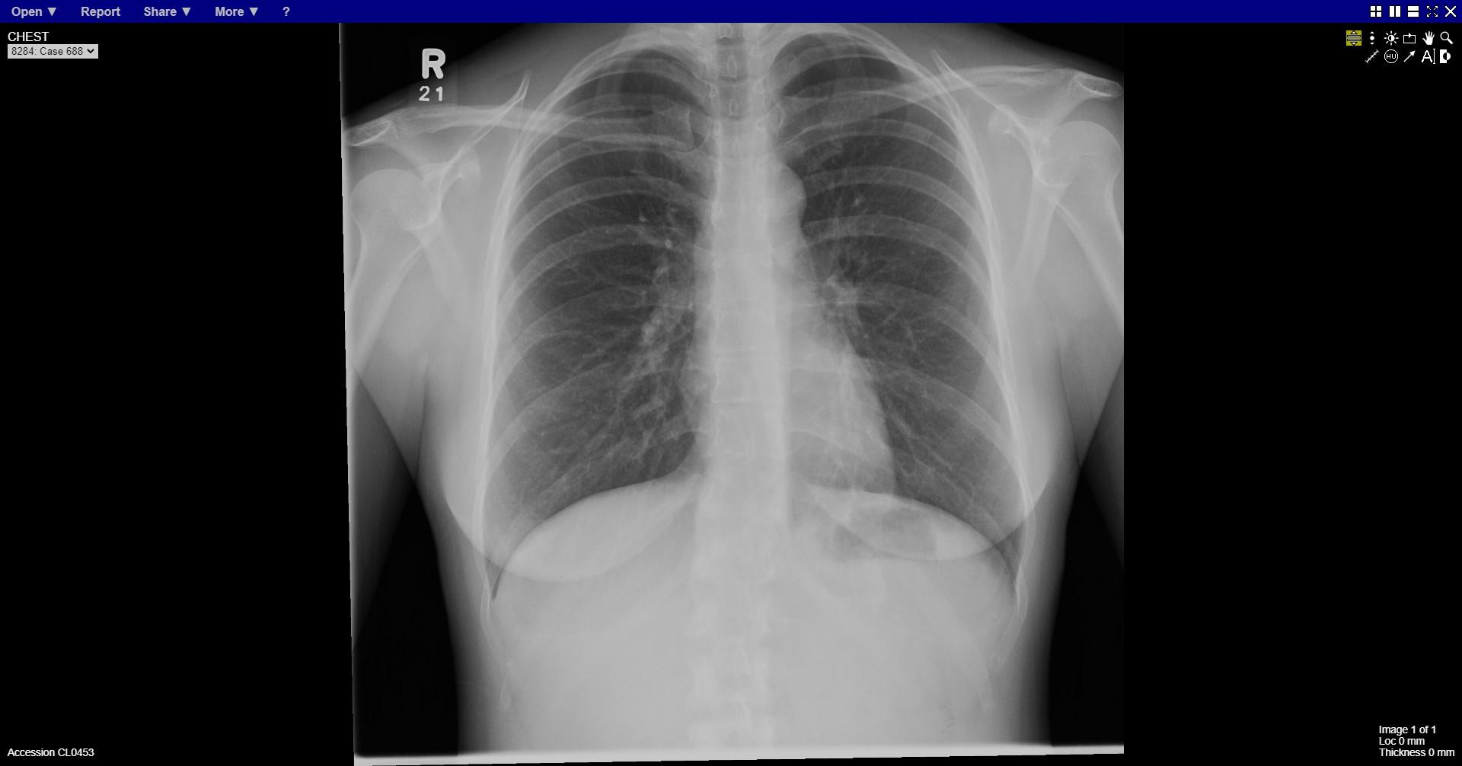
Notes:
normal

Slide 29
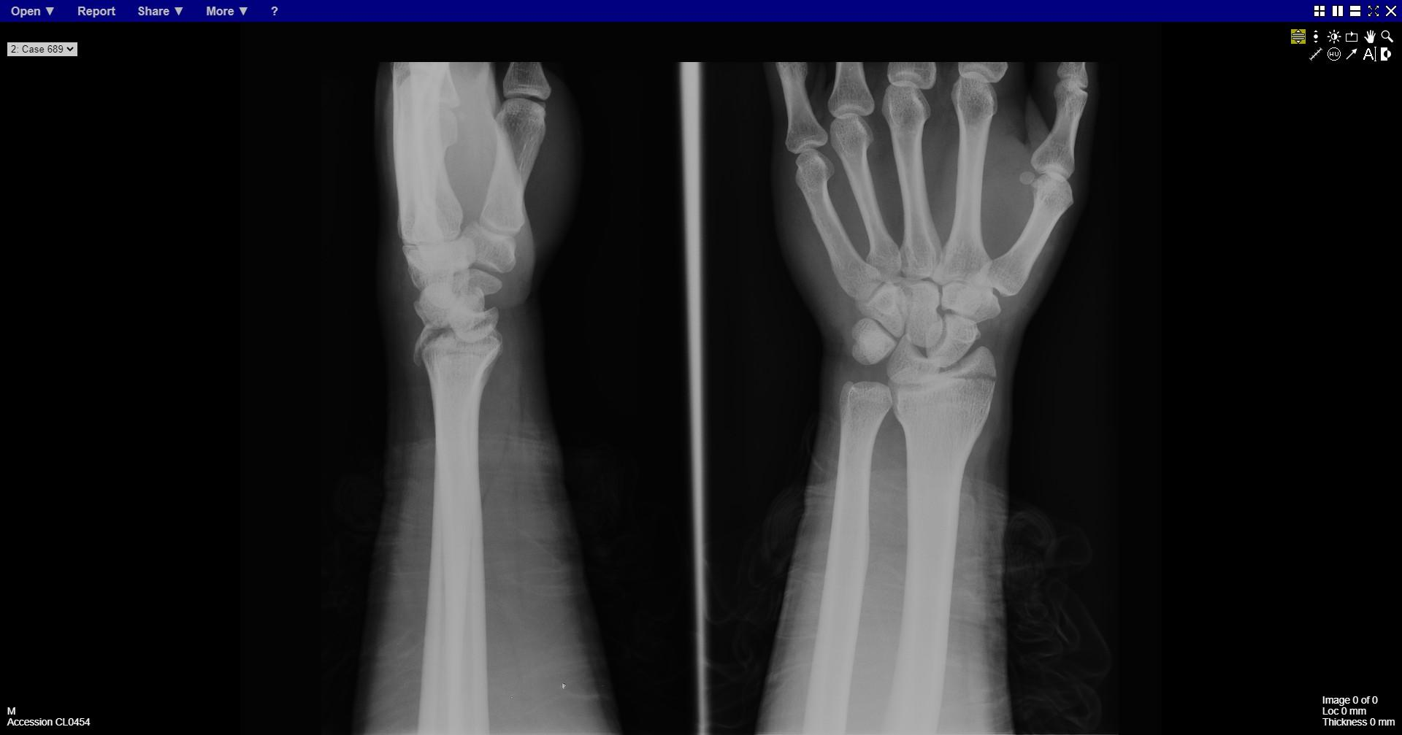
Notes:
Perilunate dislocation
Radial styloid fracture

Slide 30
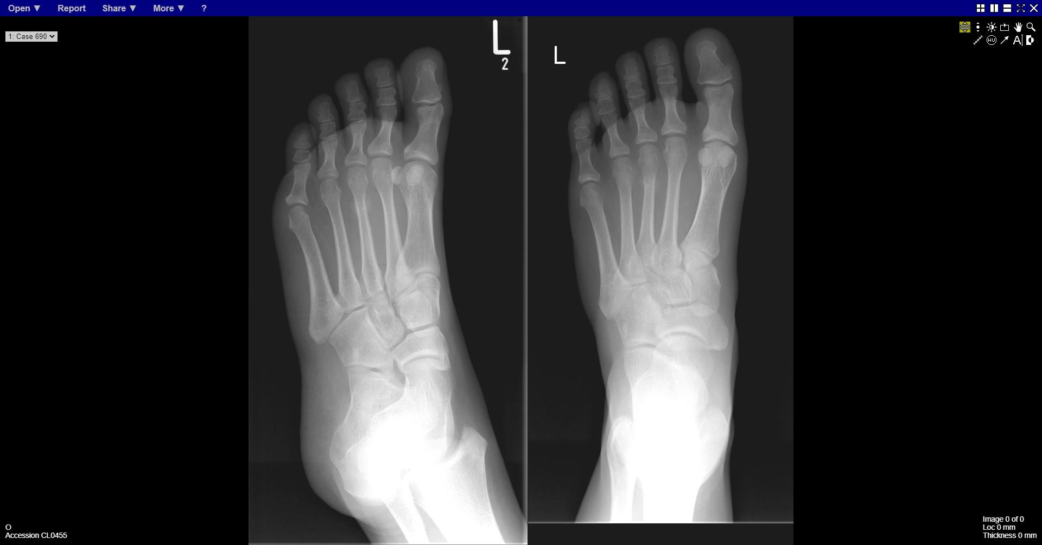
Notes:
Stress fracture 3rd metatarsal

